Slide 1
Lending Club Case Study
Nirosh Kumar GN
Prashant S

Slide 2
Business Understanding
Aim:
Improve loan approval decisions to minimize financial loss and missed opportunities.
Analysis :
The dataset contains information on past approved loan applicants, including whether they fully repaid, are currently repaying, or defaulted (charged-off). Rejected loan applications are not included.
Loan Risk Analysis:
Balancing Business Growth and Financial Risk

Slide 3
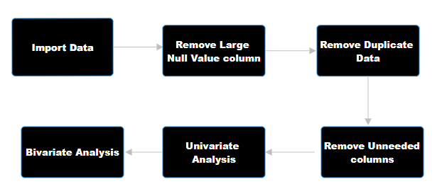
Data Preprocessing and Analysis Flow

Slide 4
Univariate Analysis

Slide 5
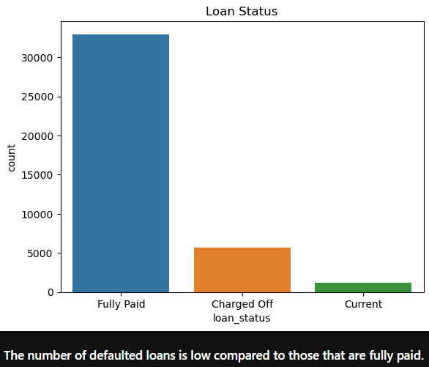
Distribution of Loan Status
The number of charged off loan is much smaller(14.5%) compared to total count.

Slide 6
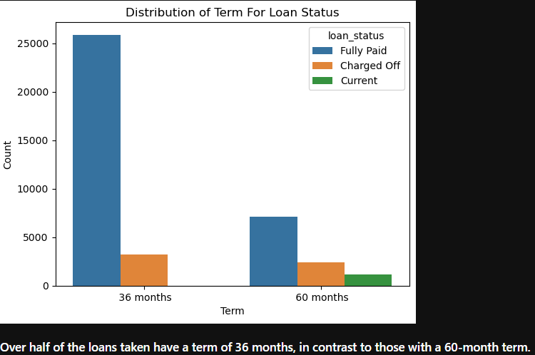
Distribution of Term for Loan Status
Loan amounts increase with interest rates up to 17.5%, then decline, suggesting higher rates deter borrowing

Slide 7
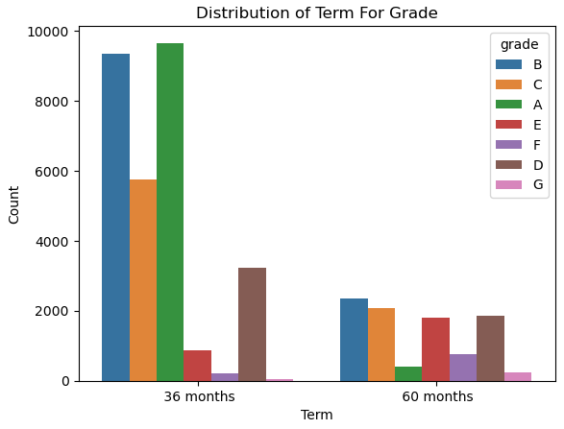
Distribution of Term For Grade
Loans with a 36-month term are primarily composed of grade A and B loans, while loans with a 60-month term mostly consist of grade B, C, and D loans.

Slide 8
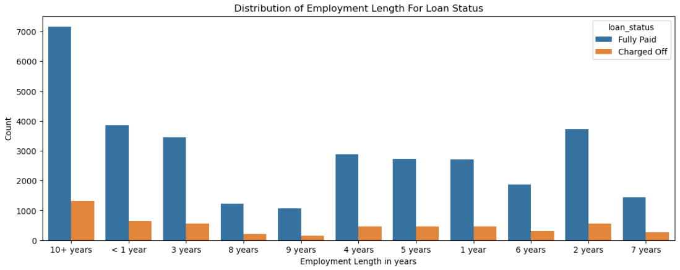
Distribution of Employment Length
Employees with over 10 years of experience are more likely to either default or fully repay their loans.

Slide 9
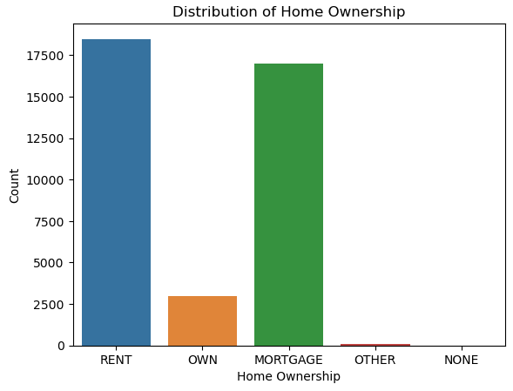
Distribution of Home Ownership
The majority of borrowers do not own property and are either on a mortgage or renting.

Slide 10
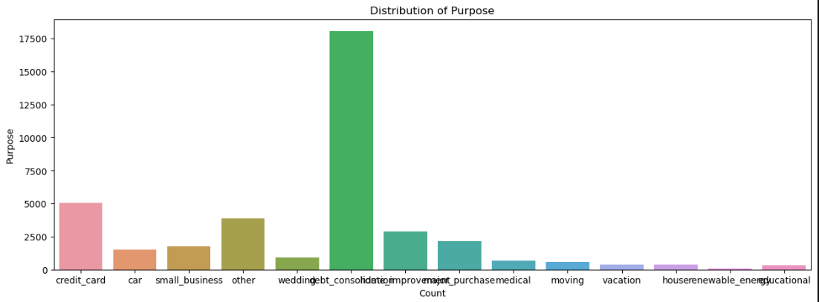
Distribution of Purpose
A significant portion of loans are taken for debt consolidation, followed by credit card repayment.

Slide 11
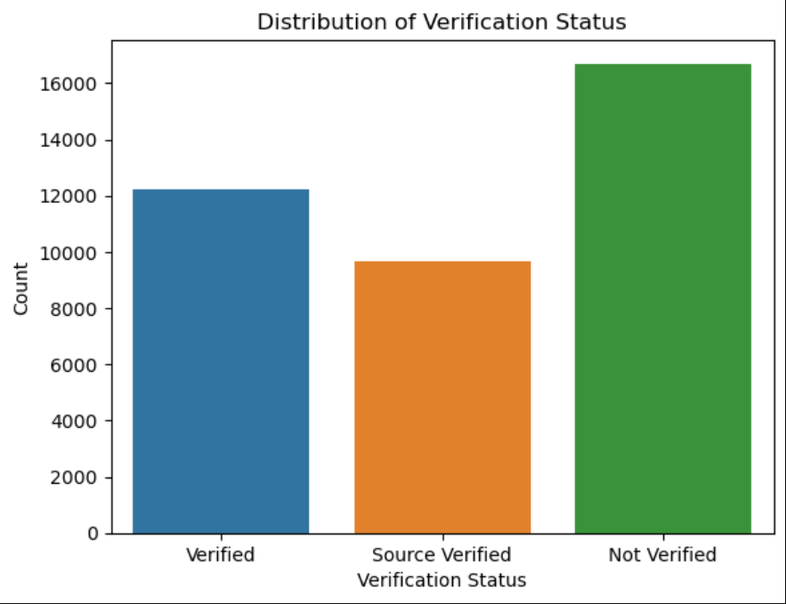
Distribution of Verification Status
Approximately 50% of the borrowers are either company-verified or have their income source verified.

Slide 12
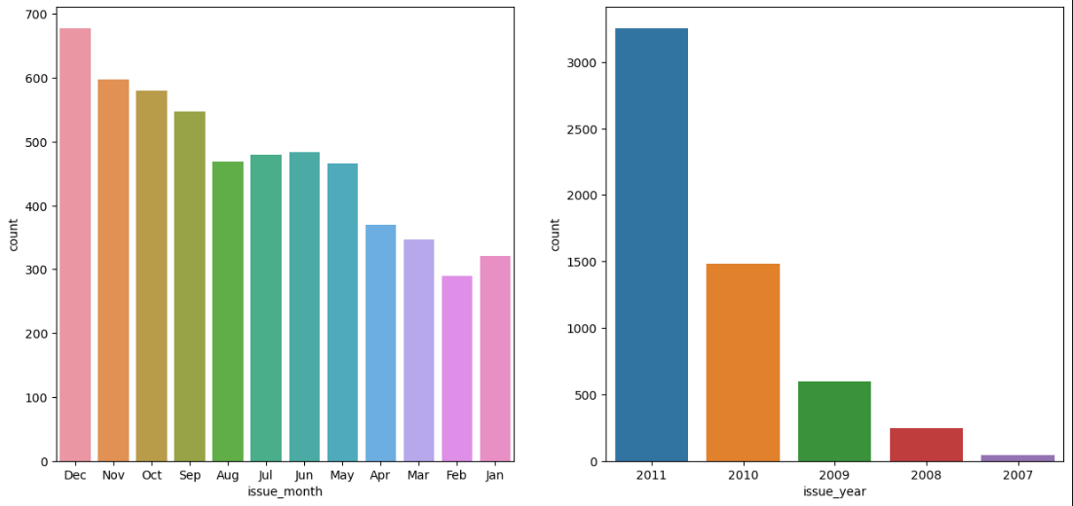
Distribution of Issued Month and Year
The highest number of defaults occurred when loans were issued in December. Additionally, loans issued in 2011 saw a higher default rate compared to other years.

Slide 13
Bivariate Analysis

Slide 14
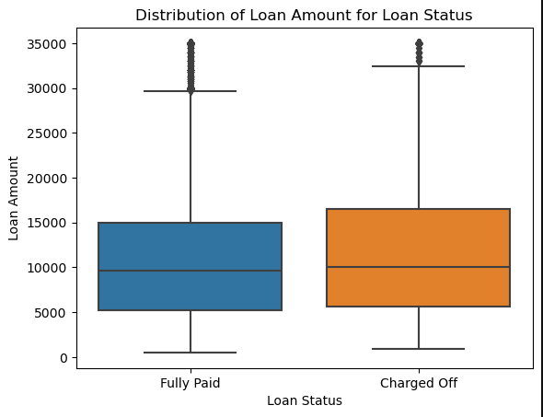
Loan Amount VS Loan Status
The total fully paid amount, at 358,049,725, is significantly larger compared to the charged-off amount, indicating a higher proportion of successfully repaid loans.

Slide 15
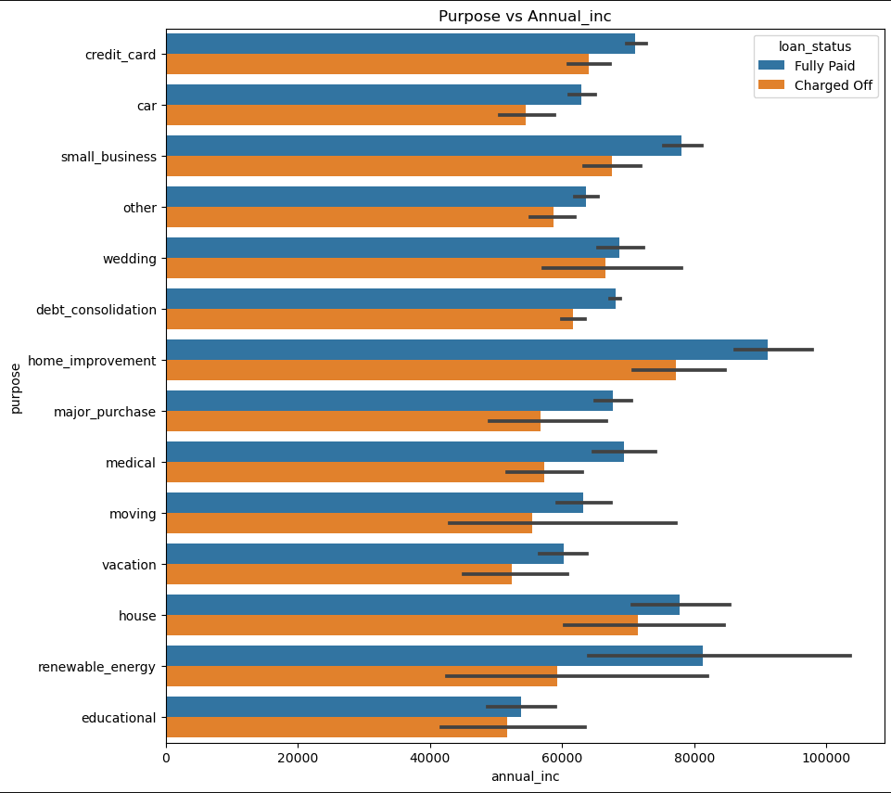
Annual Income VS Loan Purpose
Applicants with higher salaries predominantly applied for loans related to 'home improvement' 'house' and 'renewable energy'.

Slide 16
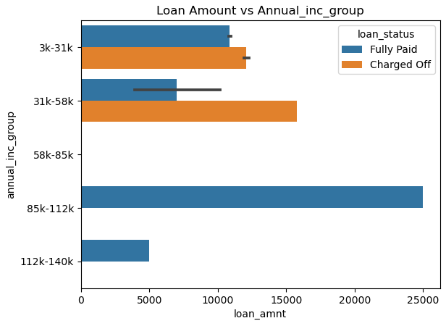
Annual Income VS Loan Amount
Borrowers in the $85k to $112k annual income bracket have the largest loan amounts.

Slide 17
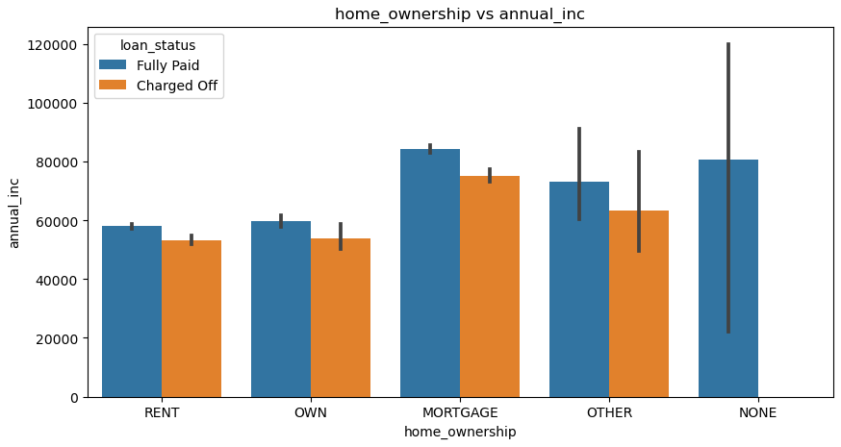
Annual Income VS Home Ownership
Borrowers with a mortgage tend to have the highest annual income compared to other home ownership types

Slide 18
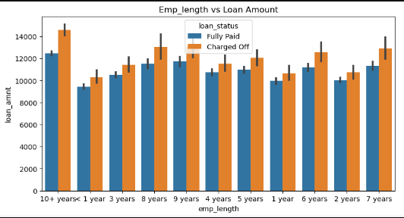
Loan Amount VS Employee Length
Employees with longer working history got the loan approved for a higher amount.

Slide 19
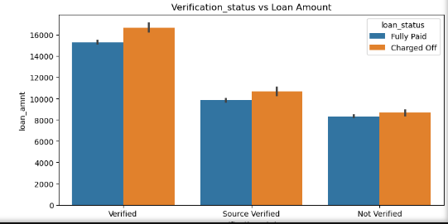
Loan Amount VS Verification Status
The verification status indicates that there are more verified loans, with a total amount of 189,663,350, compared to other statuses.

Slide 20
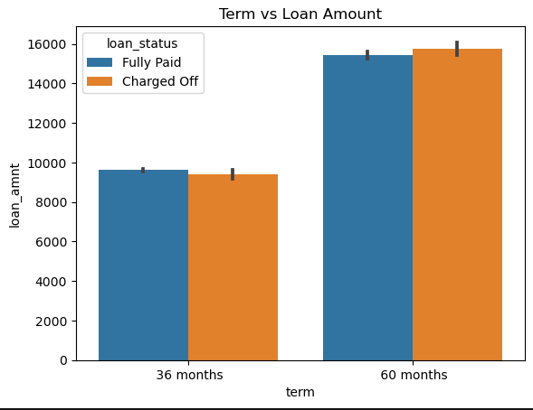
Term VS Loan Amount
The majority of loan amounts are associated with a 36-month term, in comparison to a 60-month term.

Slide 21
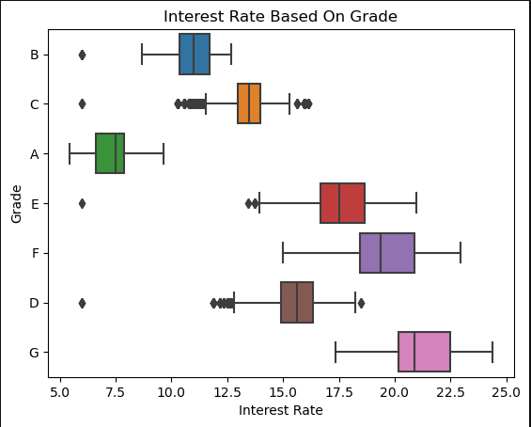
Comparison of Interest Rate based on Grade
The B grade loans, with an amount of 128,515.86, carry higher interest rates compared to other grades

Slide 22
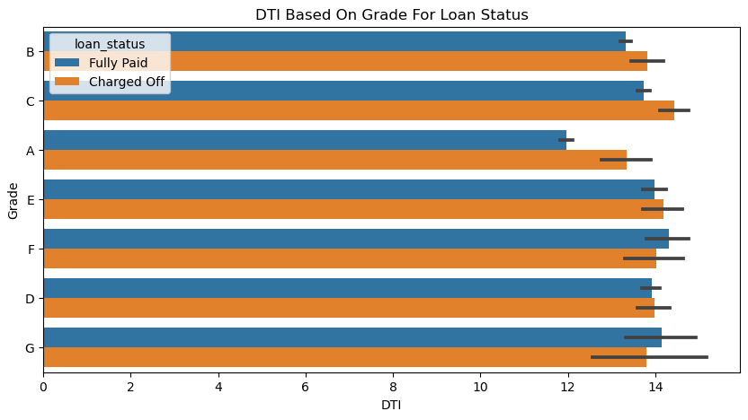
Comparison of DTI over Grade for Loan Status
The B grade loans, with a DTI of 156,264.41, have a higher debt-to-income ratio compared to other grades.

Slide 23
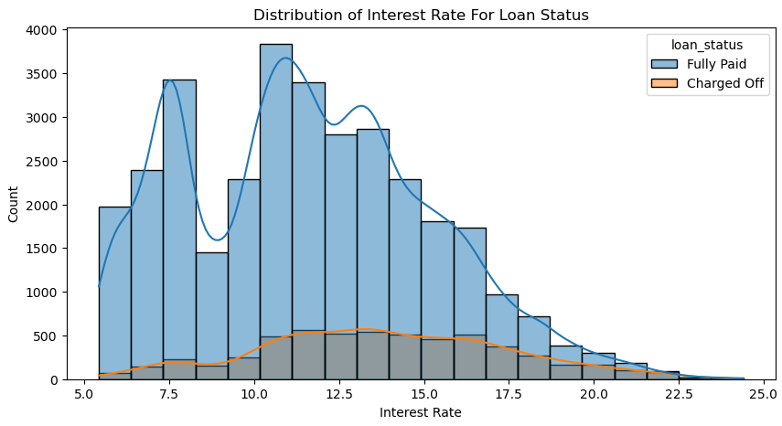
Distribution of Interest Rate based on Loan Status
Loan amounts increase with interest rates up to 17.5%, then decline, suggesting higher rates deter borrowing

Slide 24
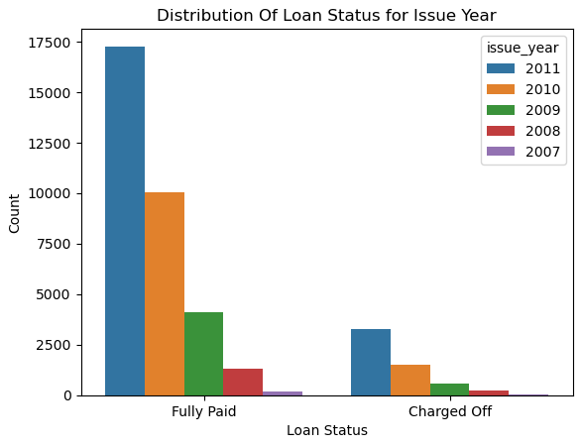
Distribution Of Loan Status for Issue Year
The exponential increase in loans over the years suggests a significant rise in the debt-to-income (DTI) ratio, while the rate of loan defaults is decreasing

Slide 25
Univariate Analysis
The number of fully paid loans is significantly higher compared to loans that are either charged-off or still current.
Over half of the loans taken have a term of 36 months, in contrast to those with a 60-month term.
The interest rates are predominantly concentrated in the 5-10 and 10-15 ranges, with a noticeable dip around the 10% mark.
Most borrowers have more than 10 years of work experience.
Employees with over 10 years of experience are more likely to either default or fully repay their loans.

Slide 26
Univariate Analysis
Annual income exhibits a left-skewed distribution, indicating that the majority of borrowers have relatively low incomes compared to the rest.
A significant portion of loans are taken for debt consolidation, followed by credit card repayment.
The highest number of defaults occurred when loans were issued in December. Additionally, loans issued in 2011 saw a higher default rate compared to other years.
Loans with a 36-month term are primarily composed of grade A and B loans, while loans with a 60-month term mostly consist of grade B, C, and D loans
The majority of borrowers do not own property and are either on a mortgage or renting. Approximately 50% of the borrowers are either company-verified or have their income source verified.

Slide 27
Bivariate Analysis
Applicants with higher salaries predominantly applied for loans related to 'home improvement' 'house' and 'renewable energy’.
Borrowers in the $85k to $112k annual income bracket have the largest loan amounts.
Borrowers with a mortgage tend to have the highest annual income compared to other home ownership types
Employees with longer working history got the loan approved for a higher amount.
The verification status indicates that there are more verified loans, with a total amount of 189,663,350, compared to other statuses.
The majority of loan amounts are associated with a 36-month term, in comparison to a 60-month term.

Slide 28
Bivariate Analysis
The total fully paid amount, at 358,049,725, is significantly larger compared to the charged-off amount, indicating a higher proportion of successfully repaid loans.
The B grade loans, with an amount of 128,515.86, carry higher interest rates compared to other grades .
The B grade loans, with a DTI of 156,264.41, have a higher debt-to-income ratio compared to other grades
Loan amounts increase with interest rates up to 17.5%, then decline, suggesting higher rates deter borrowing
The exponential increase in loans over the years suggests a significant rise in the debt-to-income (DTI) ratio, while the rate of loan defaults is decreasing.

Slide 29
Conclusion
Loan Tenure and Default Risk:
* Loans with a 60-month term appear to be riskier compared to 36-month loans, as they include more B, C, and D grade loans, which are generally associated with higher interest rates and debt-to-income (DTI) ratios.
Income and Loan Behavior:
* Borrowers with higher annual incomes tend to take out larger loans, especially for home-related improvements and renewable energy projects.
* Despite higher incomes, the propensity to default seems higher in certain income brackets, such as the $85k to $112k range. Income alone isn't a perfect indicator of repayment capacity.
Employment and Risk:
* Applicants with more than 10 years of work experience make up a large portion of both fully paid and defaulted loans, suggesting that work experience alone isn't a decisive factor in loan approval.
* However, those with longer employment histories tend to be approved for larger loans, potentially leading to increased default risk due to higher financial burdens.
Interest Rate Impact:
* Loans with interest rates up to 17.5% are more common, but beyond this threshold, the number of loans decreases, implying higher rates may deter borrowers. However, these higher interest loans are riskier, as they are more likely to lead to default.

Slide 30
Conclusion
Debt-to-Income Ratio (DTI):
* Higher DTI ratios, particularly in B grade loans, are correlated with increased loan amounts and default rates. This indicates that borrowers taking on larger loans relative to their income are at greater risk of default.
Homeownership and Borrower Risk:
* Borrowers with mortgages tend to have higher incomes, but homeownership status (especially renting or mortgages) doesn't offer strong protection against default.
* Non-homeowners and those renting may face additional financial pressures, making them more prone to default.
Verification Status and Loan Performance:
* Verified loans have higher total amounts, and a large number of fully paid loans fall into this category. This suggests that income verification might correlate with better repayment outcomes.
Purpose and Default:
* Loans taken out for debt consolidation and credit card repayment make up a significant portion of both fully paid and defaulted loans. These loans may represent higher-risk borrowers attempting to manage existing debt, increasing their default likelihood.

Slide 31
Conclusion
Seasonal and Temporal Trends:
* Loans issued in December have a higher default rate, potentially indicating seasonal financial strain or year-end budgetary issues for borrowers.
* The year 2011 showed higher default rates, which could be reflective of macroeconomic conditions or specific changes in lending policies.
Increasing Loan Demand vs. Declining Default Rates:
* Over time, the number of loans has increased, but default rates have declined, indicating possible improvements in lending practices or risk assessment strategies. However, the increase in the DTI ratio suggests rising financial pressure on borrowers.

Slide 32
Overall Strategic Implications
Lending strategies should be adjusted to account for the increased risk in 60-month loans, higher DTI ratios, and loans issued at the end of the year
While income is an important factor, it cannot be the sole determinant in assessing borrower risk. A combination of variables, including DTI, loan term, and verification status, should be used to make more accurate risk assessments.
Additional precautions (e.g., higher interest rates or smaller loan amounts) should be taken when lending to borrowers taking out loans for debt consolidation or credit card repayment, as these tend to be high-risk categories.

